Slide 1

SNIPE TEAM
12 January 2018
www.snipe.co.in
1
Notes:
1

Slide 2



Slide 3

CONTENTS
INTRODUCTION
HISTORY
WHY ANGULAR
GETTING STARTED
ARCHITECTURAL PATTERN
ARCHITECTURAL PATTERN-MVC
TYPESCRIPT
MODULES
COMPONENTS
TEMPLATES
METADATA
SERVICES
ROUTES
DIRECTIVES OF ANGULARJS
1ST APP
WHAT YOULL NEED
PACKAGE.SON FILE
SAMPLE POJECT OVERVIEW
ANGULAR APP
FOLDER STRUCTURE
ADVANTAGES

Slide 4
INTRODUCTION
Angular 2 is an open source JavaScript framework to build web applications in HTML and JavaScript.
Client side application.
It is essentially a structure that helps you create applications faster by providing a number of service and objects that makes things easier for app developers.
The Angular JS2 is a dramatic upgrade to the previous version of the framework. It is really a rethinking of how applications should be built.

Slide 5

HISTORY
Started in 2009.
By misko hevery and adams abrons.
Sponsored by Google.
Open to community.

Slide 6
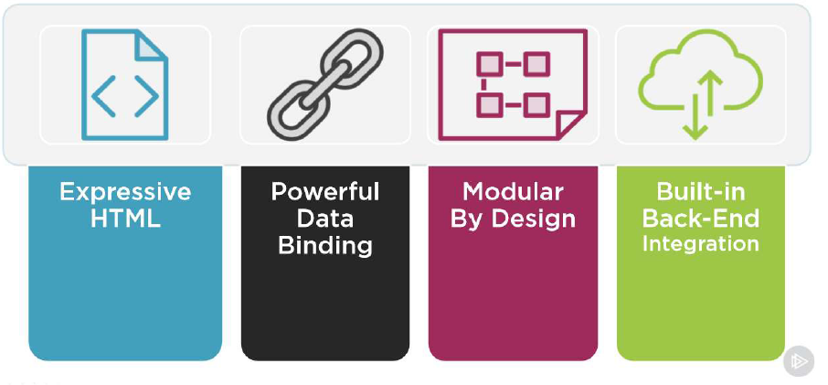
WHY ANGULAR

Slide 7
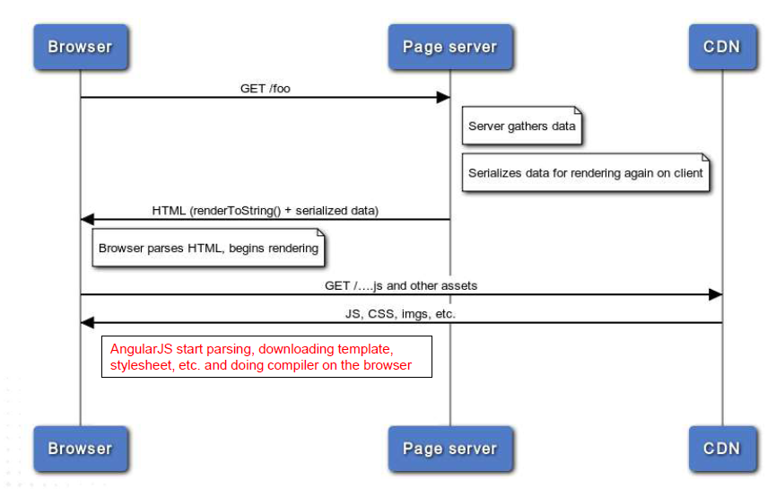
Single Page Application:
WHY ANGULAR

Slide 8
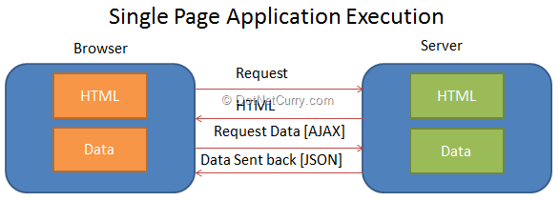
WHY ANGULAR
Single-Page Applications (SPAs) are Web apps that load a single HTML page and dynamically update that page as the user interacts with the app.
SPAs use AJAX and HTML5 to create fluid and responsive Web apps, without constant page reloads. However, this means much of the work happens on the client side, in JavaScript.

Slide 9
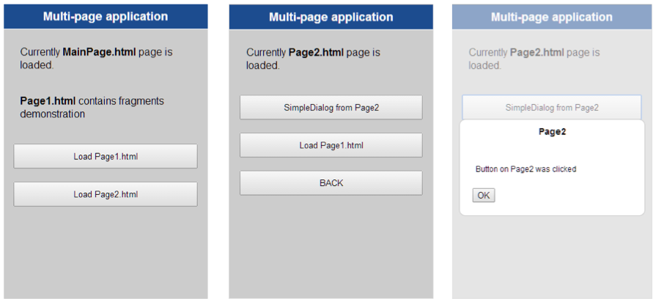
Multi Page Application:
SINGLE PAGE APP vs MULTI PAGE APPLICATION

Slide 10
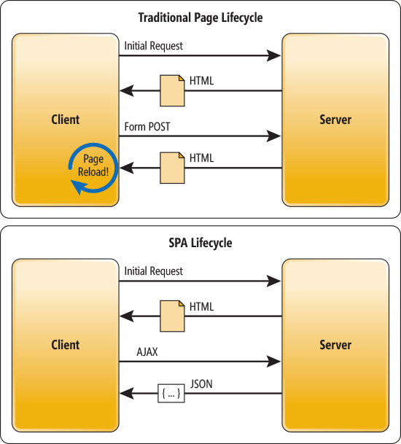
Single Page Application:
SINGLE PAGE APP vs MULTI PAGE APPLICATION

Slide 11
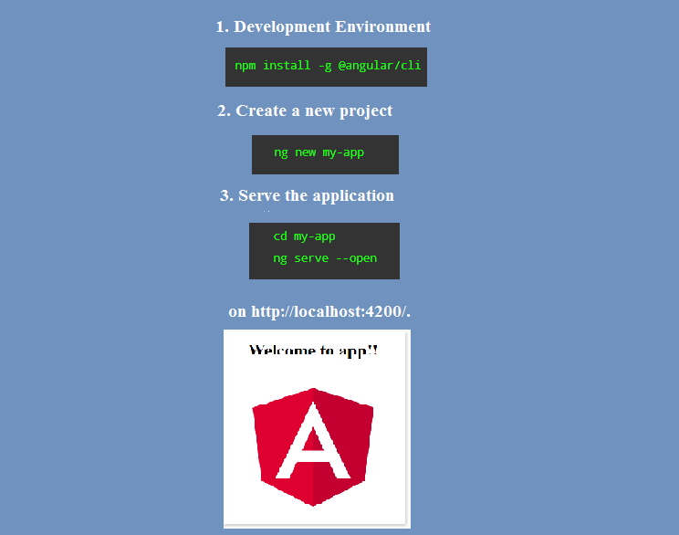
GETTING STARTED

Slide 12
MODULES
Modules are used in Angular JS to put logical boundaries in your application.
Every Angular application has at least one module— the root module, conventionally named AppModule.

Slide 13
MODULES
A module is made up of the following parts −
Bootstrap array − This is used to tell Angular which components need to be loaded so that its functionality can be accessed in the application. Once you include the component in the bootstrap array, you need to declare them so that they can be used across other components in the Angular application.
Export array − This is used to export components, directives, and pipes which can then be used in other modules.
Import array − Just like the export array, the import array can be used to import the functionality from other Angular JS modules.

Slide 14
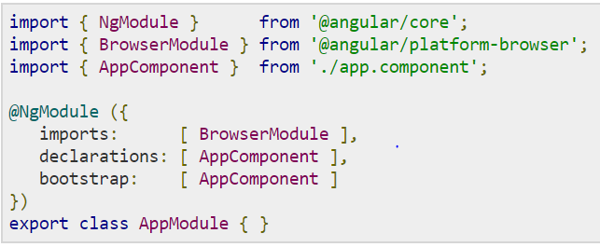
MODULES
In Visual Studio code, go to the app.module.ts folder in your app folder. This is known as the root module class.

Slide 15
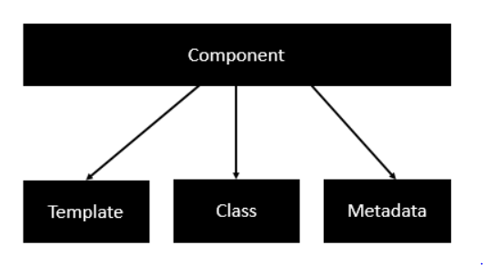
Components are a logical piece of code for Angular application.
A component controls a patch of the page, called a view.
A Component consists of the following:
COMPONENTS

Slide 16
COMPONENTS
1.Template
This is the view which needs to be rendered in the application.
Parameters
HTML Code − This is the HTML code which needs to be rendered in the application.
Class properties − These are the properties of the class which can be referenced in the template.
Syntax:
Template: ' <HTML code> class properties '
Example(template):
<div>
<h1>{{appTitle}}</h1>
<div>SNIPE IT</div>
</div>

Slide 17
COMPONENTS
2. Class
The class decorator. The class is defined in TypeScript. The class normally has the following syntax in TypeScript.
Parameters
Classname − This is the name to be given to the class.
Propertyname − This is the name to be given to the property.
PropertyType − Since TypeScript is strongly typed, you need to give a type to the property.
Value − This is the value to be given to the property.
Syntax
class classname { Propertyname: PropertyType = Value }
Example
export class AppComponent { appTitle: string = 'Welcome'; }

Slide 18
COMPONENTS
3.Metadata
This is used to decorate Angular class with additional information.
Let’s take a look at the completed code with our class, template, and metadata.
Example:
import { Component } from '@angular/core';
@Component ({
selector: 'my-app',
template: ` <div>
<h1>{{appTitle}}</h1>
<div>SNIPE IT</div>
</div> `
, }) export class AppComponent {
appTitle: string = 'Welcome to';
}

Slide 19
TEMPLATES
There are other ways to define a template and that can be done via the templateURL command. The simplest way to use this in the component is as follows.
Parameters
viewname − This is the name of the app component module.
After the viewname, the component needs to be added to the file name.
Following are the steps to define an inline template.
Step 1 − Create a file called app.component.html. This will contain the html code for the view.
Step 2 − Add the following code in the above created file.
<div>{{appTitle}} SNIPE IT </div> This defines a simple div tag and references the appTitle property from the app.component class.
Syntax
templateURL: viewname.component.html
<div>{{appTitle}} SNIPE IT </div>

Slide 20
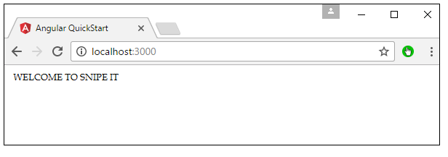
TEMPLATES
Step 3 − In the app.component.ts file, add the following code.
Step 4 − Run the code in the browser, you will get the following output.
import { Component } from '@angular/core'; @Component ({ selector: 'my-app', templateUrl: 'app/app.component.html' }) export class AppComponent { appTitle: string = 'Welcome'; }

Slide 21
DIRECTIVES OF ANGULAR JS
Directives list
ngif
ngFor
ngIf
The ngif element is used to add elements to the HTML code if it evaluates to true, else it will not add the elements to the HTML code.
Syntax
*ngIf = 'expression'
If the expression evaluates to true then the corresponding gets added, else the elements are not added.

Slide 22
DIRECTIVES OF ANGULAR JS
ngIf
Example:
Step 1 − First add a property to the class named appStatus. This will be of type Boolean. Let’s keep this value as true.
import { Component } from '@angular/core'; @Component ({
selector: 'my-app',
templateUrl: 'app/app.component.html'
})
;
} export class AppComponent {
appTitle: string = 'Welcome';
appStatus: boolean = true

Slide 23
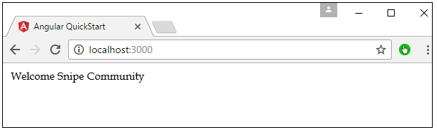
DIRECTIVES OF ANGULAR JS
ngIf
Example:
Step 2 − Now in the app.component.html file, add the following code.
Once we add the above code, we will get the following output in the browser.
Output:
<div *ngIf = 'appStatus'>{{appTitle}} Snipe Community </div>

Slide 24
DIRECTIVES OF ANGULAR JS
ngFor
The ngFor element is used to elements based on the condition of the For loop.
Syntax
*ngFor = 'let variable of variablelist'
The variable is a temporary variable to display the values in the variablelist.
Let’s now take a look at an example of how we can use the *ngFor directive.

Slide 25
DIRECTIVES OF ANGULAR JS
ngFor
Example:
Step 1 − First add a property to the class named appList. This will be of the type which can be used to define any type of arrays.
import { Component } from '@angular/core'; @Component ({
selector: 'my-app',
templateUrl: 'app/app.component.html'
})
export class AppComponent {
appTitle: string = 'Welcome';
appList: any[] = [ {
"ID": "1",
"Name" : "One"
},
{
"ID": "2",
"Name" : "Two"
}
];
}

Slide 26
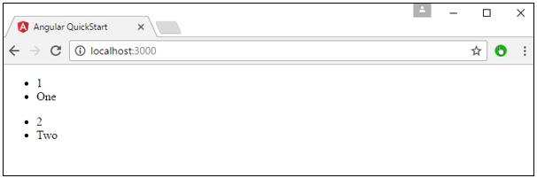
DIRECTIVES OF ANGULAR JS
ngFor
Example:
Step 2 − In the app.component.html, define the following code.
Output:
<div *ngFor = 'let lst of appList'>
<ul>
<li>{{lst.ID}}</li> <li>
{{lst.Name}}</li>
</ul>
</div>

Slide 27
SERVICES
A service is used when a common functionality needs to be provided to various modules. A service provides any value, function, or feature that your application needs.
Module 1
Module 2
Module n
services

Slide 28
@Injectable() export class classname {
}
SERVICES
The following key steps need to be carried out when creating a service.
Step 1 − Create a separate class which has the injectable decorator. The injectable decorator allows the functionality of this class to be injected and used in any Angular JS module.
Step 2 − Next in your appComponent module or the module in which you want to use the service, you need to define it as a provider in the @Component decorator.
@Component ({
providers : [classname]
})

Slide 29
import {
Injectable
} from '@angular/core';
@Injectable() export class appService { get App(): string { return "Hello world"; } }
SERVICES
Examples:
Step 1 − Create a ts file for the service called app.service.ts.
Step 2 −Place the following code in the file created above.
The Injectable decorator is imported from the angular/core module.
We are creating a class called appService that is decorated with the Injectable decorator.
We are creating a simple function called getApp, which returns a simple string called �Hello world�.

Slide 30
import {
Component } from '@angular/core'; import { appService
} from './app.service';
@Component ({ selector: 'demo-app', template: '<div>{{value}}</div>', providers: [appService] }) export class AppComponent
{ value: string = ""; constructor(private _appService: appService) { } ngOnInit(): void { this.value = this._appService.getApp();
}
}
SERVICES
Step 3 − In the app.component.ts file, place the following code.

Slide 31
ROUTES
Routes
Routes enable navigation from one view to the next as users perform application tasks. A route is equivalent to a mechanism used to control menus and submenus.
Now that you understand the benefits of SPAs and have a grasp on Angular concepts, it's time to get set up to work on the sample project.

Slide 32
FIRST APPLICATION
First application:
For creating angular js app, we require an editor like vscode and a latest browser.
We can easily embed angular code in html
We must use the ng-app directive where we want to put Angular JS code in HTML.

Slide 33
WHAT YOU'LL NEED
To complete the sample project, you need Node.js and Angular CLI (a command-line interface for Angular) installed on your development PC:
To install Node.js:
  Download the version for your system and choose the default options to complete the installation.
  Run node -v from your OS command line to verify the version number — in my case, v6.9.1.
The Node Package Manager (NPM) is automatically installed along with Node. Type npm -v to see its version number. NPM is used in the background when you install packages from the public NPM repository. A common NPM command is npm install, which is used to download the package versions listed in your Angular project's package.json file.

Slide 34
To install Angular CLI:
Run npm install -g angular/cli to install the version that I used for the sample application. (If you want to try a different build, visit the CLI site.) Installation takes about 10 minutes to complete.
After successful installation, type ng -v at the OS command line to see your CLI version number — in my case:
WHAT YOU'LL NEED
angular-cli: 1.6.3
node: 9.3.0
os: win32 x64

Slide 35
THE PACKAGE.JSON FILE
The package.json file — a key metadata file in an Angular application — contains the details of the application and its dependent packages.
This file is the most important one in an Angular application, especially when you move your code from one computer to another, and during upgrades.
The package.json file controls the version of the packages that need to be installed.

Slide 36
THE PACKAGE.JSON FILE
Here are some valid statements from a package.json file:
{ "dependencies" :
{ "foo" : "1.0.0 - 2.9999.9999"
, "bar" : ">=1.0.2 <2.1.2"
, "baz" : ">1.0.2 <=2.3.4"
, "boo" : "2.0.1"
, "qux" : "<1.0.0 || >=2.3.1 <2.4.5 || >=2.5.2 <3.0.0"
, "til" : "^1.2"
, "elf" : "~1.2.3"
, "two" : "2.x"
, "thr" : "3.3.x"
, "lat" : "latest"
}
}

Slide 37
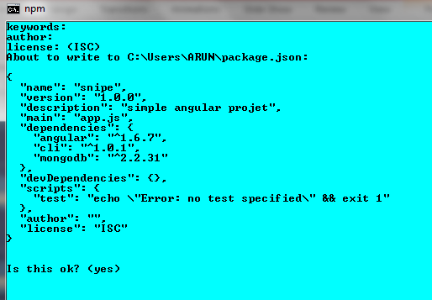
THE PACKAGE.JSON FILE
To create package.json file:
hit npm init on command prompt
Then it will ask some documentation fields like-

Slide 38
SAMPLE PROJECT OVERVIEW
The sample project consists of an out-of-the-box Angular application and a custom application that you'll develop on top of the out-of-the-box application. When you're finished, you'll have an Angular application consisting of three mini applications with features that use three web service APIs:
Weather from Yahoo!
Currency exchange
Movie details
All of the application logic will run in your browser. The server is needed only when the browser needs new data. In fact, you can shut down the server process and still work in your application because it's a SPA.

Slide 39
SAMPLE PROJECT OVERVIEW
This diagram shows the application topology:
Weather app
Services
internet
AppModule
AppComponent
menu
Movie app
Currency app

Slide 40
CREATING THE BASE APPLICATION AND MODULE
Start at your OS command line at a location where you want to put your project directory.
Creating an Angular project
Generate a new Angular project by running the following command (where demo1 is the project name):
ng new demo1

Slide 41
CREATING THE BASE APPLICATION AND MODULE
After all the required packages and the Angular base application are installed (which takes about 10 minutes), you're back at your OS command prompt. If you then list the /demo1 directory, you can see the project structure:
|— e2e
|— node_modules
|— src
angular-cli.json
karma.conf.js
package.json
protractor.conf.js
README.md
tslint.json

Slide 42
CREATING THE BASE APPLICATION AND MODULE
The ../demo/src directory's contents are:
|— app
|— assets
|— environments
favicon.ico
index.html
main.ts
polyfills.ts
styles.css
test.ts
tsconfig.json
typings.d.ts

Slide 43
CREATING THE BASE APPLICATION AND MODULE
And the ../demo1/src/app directory (the root module folder) contains the following files:
app.component.css
app.component.html
app.component.spec.ts
app.component.ts
app.module.ts
index.ts

Slide 44
CREATING THE BASE APPLICATION AND MODULE
Change to the project directory and run ng serve to start the out-of-the box Angular application.
By default, the process starts in port number 4200. If the value of your port system environment variable is other than 4200, the process will start in that port number. Optionally, you can override the default port number by running the ng serve --port 4200 command.
Open your browser and enter the URL http://localhost:4200/. Your Angular application displays app works! to indicate that the app is up, running, and ready:

Slide 45
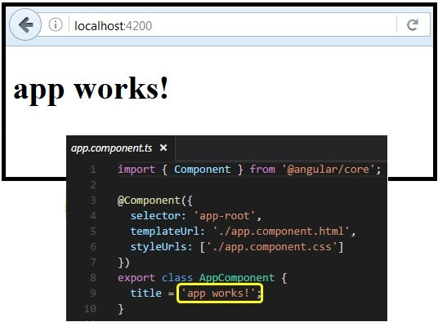
CREATING THE BASE APPLICATION AND MODULE
Open your browser and enter the URL http://localhost:4200/. Your Angular application displays app works! to indicate that the app is up, running, and ready:

Slide 46
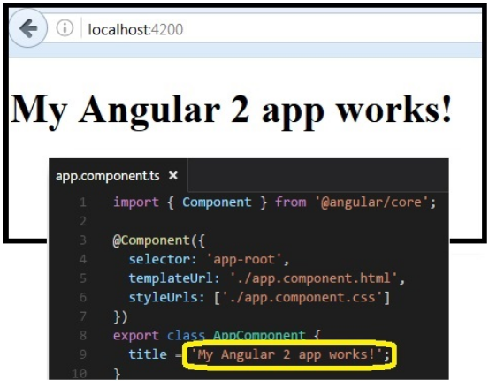
CREATING THE BASE APPLICATION AND MODULE
If you make changes to the code while the application is running, Angular is smart enough to monitor and restart the application automatically. Try editing the app.component.ts file by changing the value of the title. You can see that your browser page reflects the change:

Slide 47
ANGULAR APP
In the initial we need node js and npm
You can check the version by running the below commands.
Create a directory for our project.
node -v
npm -v
mkdir snipe
cd snipe

Slide 48
ANGULAR APP
Now add these files into your working directory.
PACKAGE.JSON
{
"name": "ciphertrick-spa-app",
"version": "1.0.0",
"scripts": {
"start": "tsc && concurrently "npm run tsc:w" "npm run lite" ",
"lite": "lite-server",
"postinstall": "typings install",
"tsc": "tsc",
"tsc:w": "tsc -w",
"typings": "typings"
},
"license": "ISC",
"dependencies": {
"@angular/common": "2.0.0",
"@angular/compiler": "2.0.0",
"@angular/core": "2.0.0",
"@angular/forms": "2.0.0",
"@angular/http": "2.0.0",
"@angular/platform-browser": "2.0.0",
"@angular/platform-browser-dynamic": "2.0.0",
"@angular/router": "3.0.0",
"@angular/upgrade": "2.0.0",

Slide 49
ANGULAR APP
Continued…
PACKAGE.JSON
"core-js": "^2.4.1",
"reflect-metadata": "^0.1.3",
"rxjs": "5.0.0-beta.12",
"systemjs": "0.19.27",
"zone.js": "^0.6.23",
"angular2-in-memory-web-api": "0.0.20",
"bootstrap": "^3.3.6"
},
"devDependencies": {
"concurrently": "^2.2.0",
"lite-server": "^2.2.2",
"typescript": "^2.0.2",
"typings":"^1.3.2"
}
}

Slide 50
ANGULAR APP
TSCONFIG.JSON
{
"compilerOptions": {
"target": "es5",
"module": "commonjs",
"moduleResolution": "node",
"outDir": "app/transpiled-js",
"sourceMap": true,
"emitDecoratorMetadata": true,
"experimentalDecorators": true,
"removeComments": false,
"noImplicitAny": false
}
}

Slide 51
ANGULAR APP
TYPINGS.JSON
{
"globalDependencies": {
"core-js": "registry:dt/core-js#0.0.0+20160725163759",
"jasmine": "registry:dt/jasmine#2.2.0+20160621224255",
"node": "registry:dt/node#6.0.0+20160909174046"
}
}

Slide 52
ANGULAR APP
SYSTEMS.CONFIG.JS
/**
* System configuration for Angular samples
* Adjust as necessary for your application needs.
*/
(function (global) {
System.config({
paths: {
// paths serve as alias
'npm:': 'node_modules/'
},
// map tells the System loader where to look for things
map: {
// our app is within the app folder
app: 'app',
// angular bundles
'@angular/core': 'npm:@angular/core/bundles/core.umd.js',
'@angular/common': 'npm:@angular/common/bundles/common.umd.js',
'@angular/compiler': 'npm:@angular/compiler/bundles/compiler.umd.js',
'@angular/platform-browser': 'npm:@angular/platform-browser/bundles/platform-browser.umd.js',
'@angular/platform-browser-dynamic': 'npm:@angular/platform-browser-dynamic/bundles/platform-browser-dynamic.umd.js',
'@angular/http': 'npm:@angular/http/bundles/http.umd.js',
'@angular/router': 'npm:@angular/router/bundles/router.umd.js',
'@angular/forms': 'npm:@angular/forms/bundles/forms.umd.js',
// other libraries
'rxjs': 'npm:rxjs',
'angular2-in-memory-web-api': 'npm:angular2-in-memory-web-api',
},

Slide 53
ANGULAR APP
Continued…
SYSTEMS.CONFIG.JS
// packages tells the System loader how to load when no filename and/or no extension
packages: {
app: {
main: './transpiled-js/main.js', //path to main.js
defaultExtension: 'js'
},
rxjs: {
defaultExtension: 'js'
},
'angular2-in-memory-web-api': {
main: './index.js',
defaultExtension: 'js'
}
}
});
})(this);

Slide 54
ANGULAR APP
Once this is done then the next step is to install all the dependencies.
Now that we are done with the dependencies and typescript setup, it’s time to start building our app. Create a folder named as app. This is where we will pace all our Angular 2 app code.
npm install
mkdir app
cd app

Slide 55
ANGULAR APP
Creating our first Angular 2 Module
n Angular 2 app comprises of a collection of modules and every app will have at least one module, which would be the root module.
Create a file named app.module.ts inside the app folder.
APP/APP.MODULE.TS
@NgModule- decorator is used to define the metadata
for our module.
BrowserModule from @angular/platform-browser is the
most important module which is required by the app
that run in browser.
The declarations and bootstrap are empty, we will add
our components there once we create one.
import { NgModule } from '@angular/core';
import { BrowserModule } from '@angular/platform-browser';
@NgModule({
imports: [ BrowserModule ], //other modules the app depends on
declarations: [], // declare all derectives and components
bootstrap : [] // root component to bootstarp
})
export class AppModule { }

Slide 56
ANGULAR APP
Creating our root component
Every Angular 2 app must have a root component, let’s create one. Create a file named app.component.ts and add the following code.
app.component.ts
Using the @Component decorator we are notifying
Angular to treat the AppComponent class as a component.
We have specified a selector and a templateUrl.
Components are nothing but Angular 2 directives with a template.
import { Component } from '@angular/core';
@Component({
selector: 'app-root',
templateUrl: './app/app.component.html',
})
export class AppComponent { }

Slide 57
ANGULAR APP
Create a file named app.component.html and add the following code.
<nav class="navbar navbar-default">
<div class="container-fluid">
<div class="navbar-header">
<div class="collapse navbar-collapse" id="bs-example-navbar-collapse-1">
<ul class="nav navbar-nav">
<li><a>Home</a></li>
<li><a>About</a></li>
</ul>
</div>
</div>
</div>
</nav>
<div class="container">
<div class="row">
<!-- routing here -->
</div>
</div>

Slide 58
ANGULAR APP
Now that our root component is ready, we have to add it to our app module.
APP/APP.MODULE.TS
We have first imported our AppComponent and added it to declarations and bootstrap.
import { NgModule } from '@angular/core';
import { BrowserModule } from '@angular/platform-browser';
import { AppComponent } from './app.component';
@NgModule({
imports: [ BrowserModule ], //other modules the app depends on
declarations: [ AppComponent ], // declare all derectives and components
bootstrap : [ AppComponent ] // root component to bootstarp
})
export class AppModule { }

Slide 59
ANGULAR APP
Bootstrapping our root Module
One of the most important thing in an Angular 2 application is to bootstrap the root module. This by convention is done in a file named main.ts.
main.ts
import { platformBrowserDynamic } from '@angular/platform-browser-dynamic';
import { AppModule } from './app.module';
const platform = platformBrowserDynamic();
platform.bootstrapModule(AppModule);

Slide 60
ANGULAR APP
Adding index.html to load our app
Now that we have the backbone of our Angular 2 app ready, all we need is a web-page to load our app into the browser. Create a file named index.html just outside the app folder.
              index.html
Here we are loading a few files including
our systems.config.js. We have also added
our root component selector app-root, this
is where our app will load. Also, we have
added a bit of application-wide styles in
styles.css.
<html>
<head>
<title>Snipe Application</title>
<meta charset="UTF-8">
<meta name="viewport" content="width=device-width, initial-scale=1">
<link rel="stylesheet" href="node_modules/bootstrap/dist/css/bootstrap.min.css">
<link rel="stylesheet" href="styles.css">
<!-- 1. Load libraries -->
<!-- Polyfill(s) for older browsers -->
<script src="node_modules/core-js/client/shim.min.js"></script>
<script src="node_modules/zone.js/dist/zone.js"></script>
<script src="node_modules/reflect-metadata/Reflect.js"></script>
<script src="node_modules/systemjs/dist/system.src.js"></script>
<!-- 2. Configure SystemJS -->
<script src="systemjs.config.js"></script>
<script>
System.import('app').catch(function(err){ console.error(err); });
</script>
</head>
<!-- 3. Display the application -->
<body>
<app-root>Loading...</app-root>
</body>

Slide 61
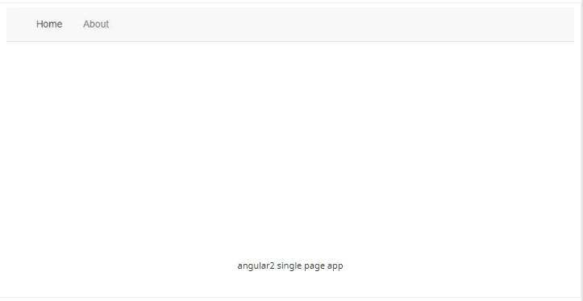
ANGULAR APP
Run Our Angular 2 Application
To run the application hit the below command.
If you have followed everything correctly, you should see a page with a navbar and two links running on http://localhost:3000. Just like it’s shown in the below image.
npm start

Slide 62
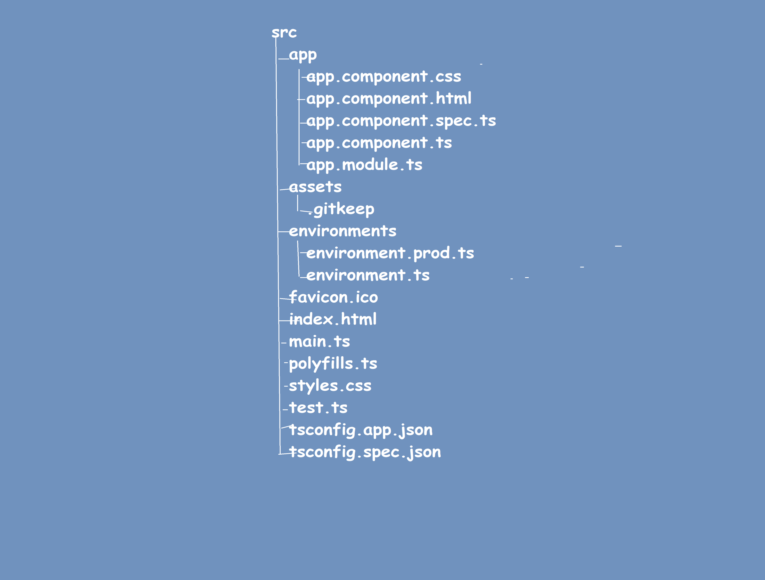
FOLDER STRUCTURE
app
app.component.css
app. component.html
app. component.spec.ts
app. component.ts
app.module.ts
assets
gitkeep
environments
environment.prod.ts
environment.ts
favicpon.ico
index.html
main.ts
polyfills.ts
styles.css
test.ts
tconfig.app.json
tscofig.spec.json

Slide 63

Disadvantages:
Disadvantages
Angular is big and complicated.
2. The lifecycle of Angular application is complex.
3. 3rd-party modules

Slide 64
Advantages:
ADVANTAGES
1. It gives the ability to make Single Page Application in a perfect and viable way.
2. It gives information restricting ability to HTML. In this manner, it gives client a rich and responsive experience.
3. AngularJS code is unit testable.
4. AngularJS gives reusable segments.

Slide 65
FAQ’s
What is Angular 2?
What are the key components of Angular 2?
Explain Modules in Angular 2.
Explain Components in Angular 2.
What are Angular 2 directives? Explain with examples.
How will you handle errors in Angular 2 applications?
What is routing?
What is CLI?
What is Dependency Injection? Explain with example.
Explain tsconfig.json file.

Slide 66
FAQ’s
11. This file contains information about Angular 2 project. Following are the typical settings in the file.
12. Explain app.module.ts file.
13. When ngOnChanges event get called in Angular 2 Application Lifecycle?

Slide 67


